Slide 1
In the Name of God

Slide 2
Polyoma virus in the Renal Transplantation
Hassan Argani MD.

Slide 3

Definitions& Risk factors
Clinical manifestations
My Talk
Diagnosis
Treatment

Slide 4
Definitions& Risk factors
Clinical manifestations
Diagnosis
Treatment

Slide 5
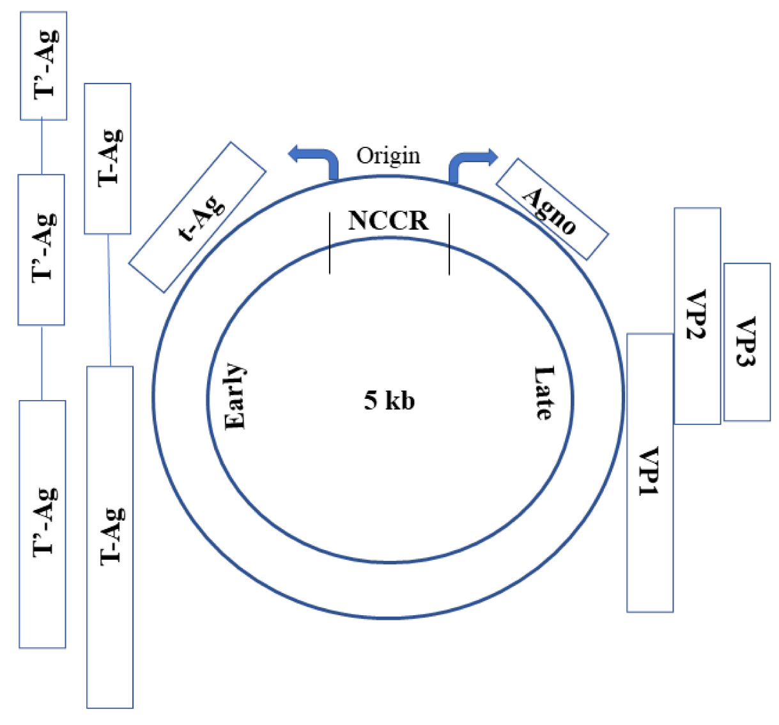
BKV Genome
The T antigen is responsible for cell immortalization and the establishment of latent infection
Agno antigen aids to assembly of viral particles
NCCR
VP Ags are mediated to cell entry
BKV Type 1
BKV Type 4
BKV Type 2
BKV Type 3

Slide 6
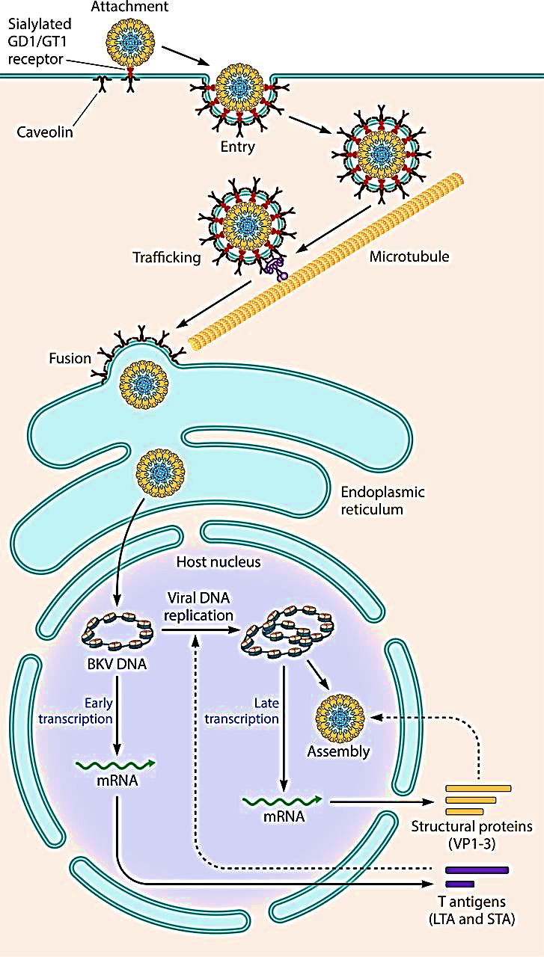

Slide 7
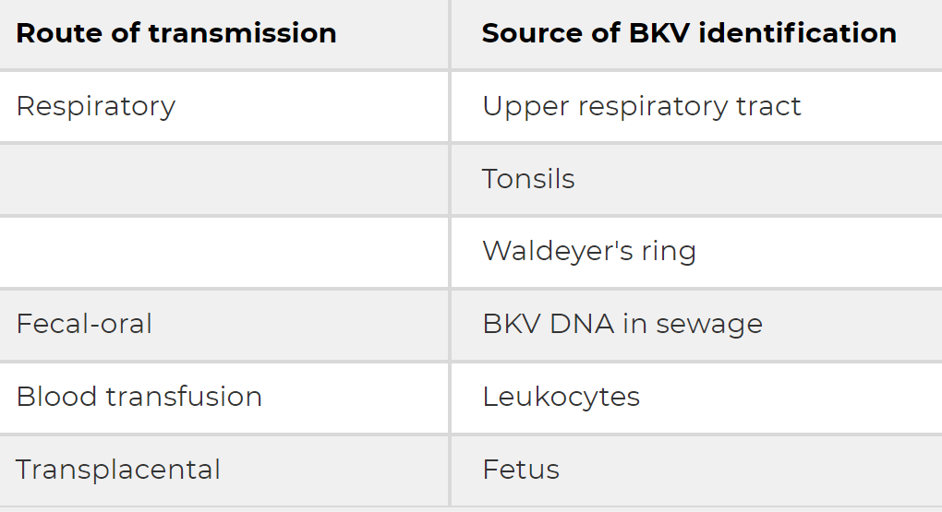
Route of transmission of BKV

Slide 8
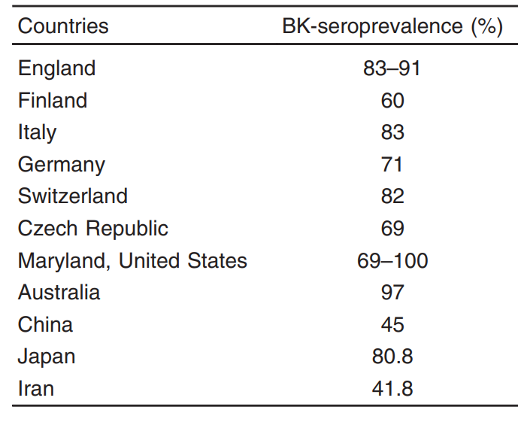
Seroprevalence of BK virus in general public in some countries
Nephrology and Transplantation 2020, 20:127–150

Slide 9
Risk factors for BKVN
When immunosuppression is more intense
Transplant from a BV seropositive donor to a seronegative recipient.
Donor BKV viruria prior to transplant
older age
Ureteral stent placement
ABO incompatibility
Rejection or ischemia of the transplanted kidney
Delayed graft function
HLA mismatch
Specific HLA-C alleles
BKV polymorphisms
Transplantation from an HCV-positive donor

Slide 10
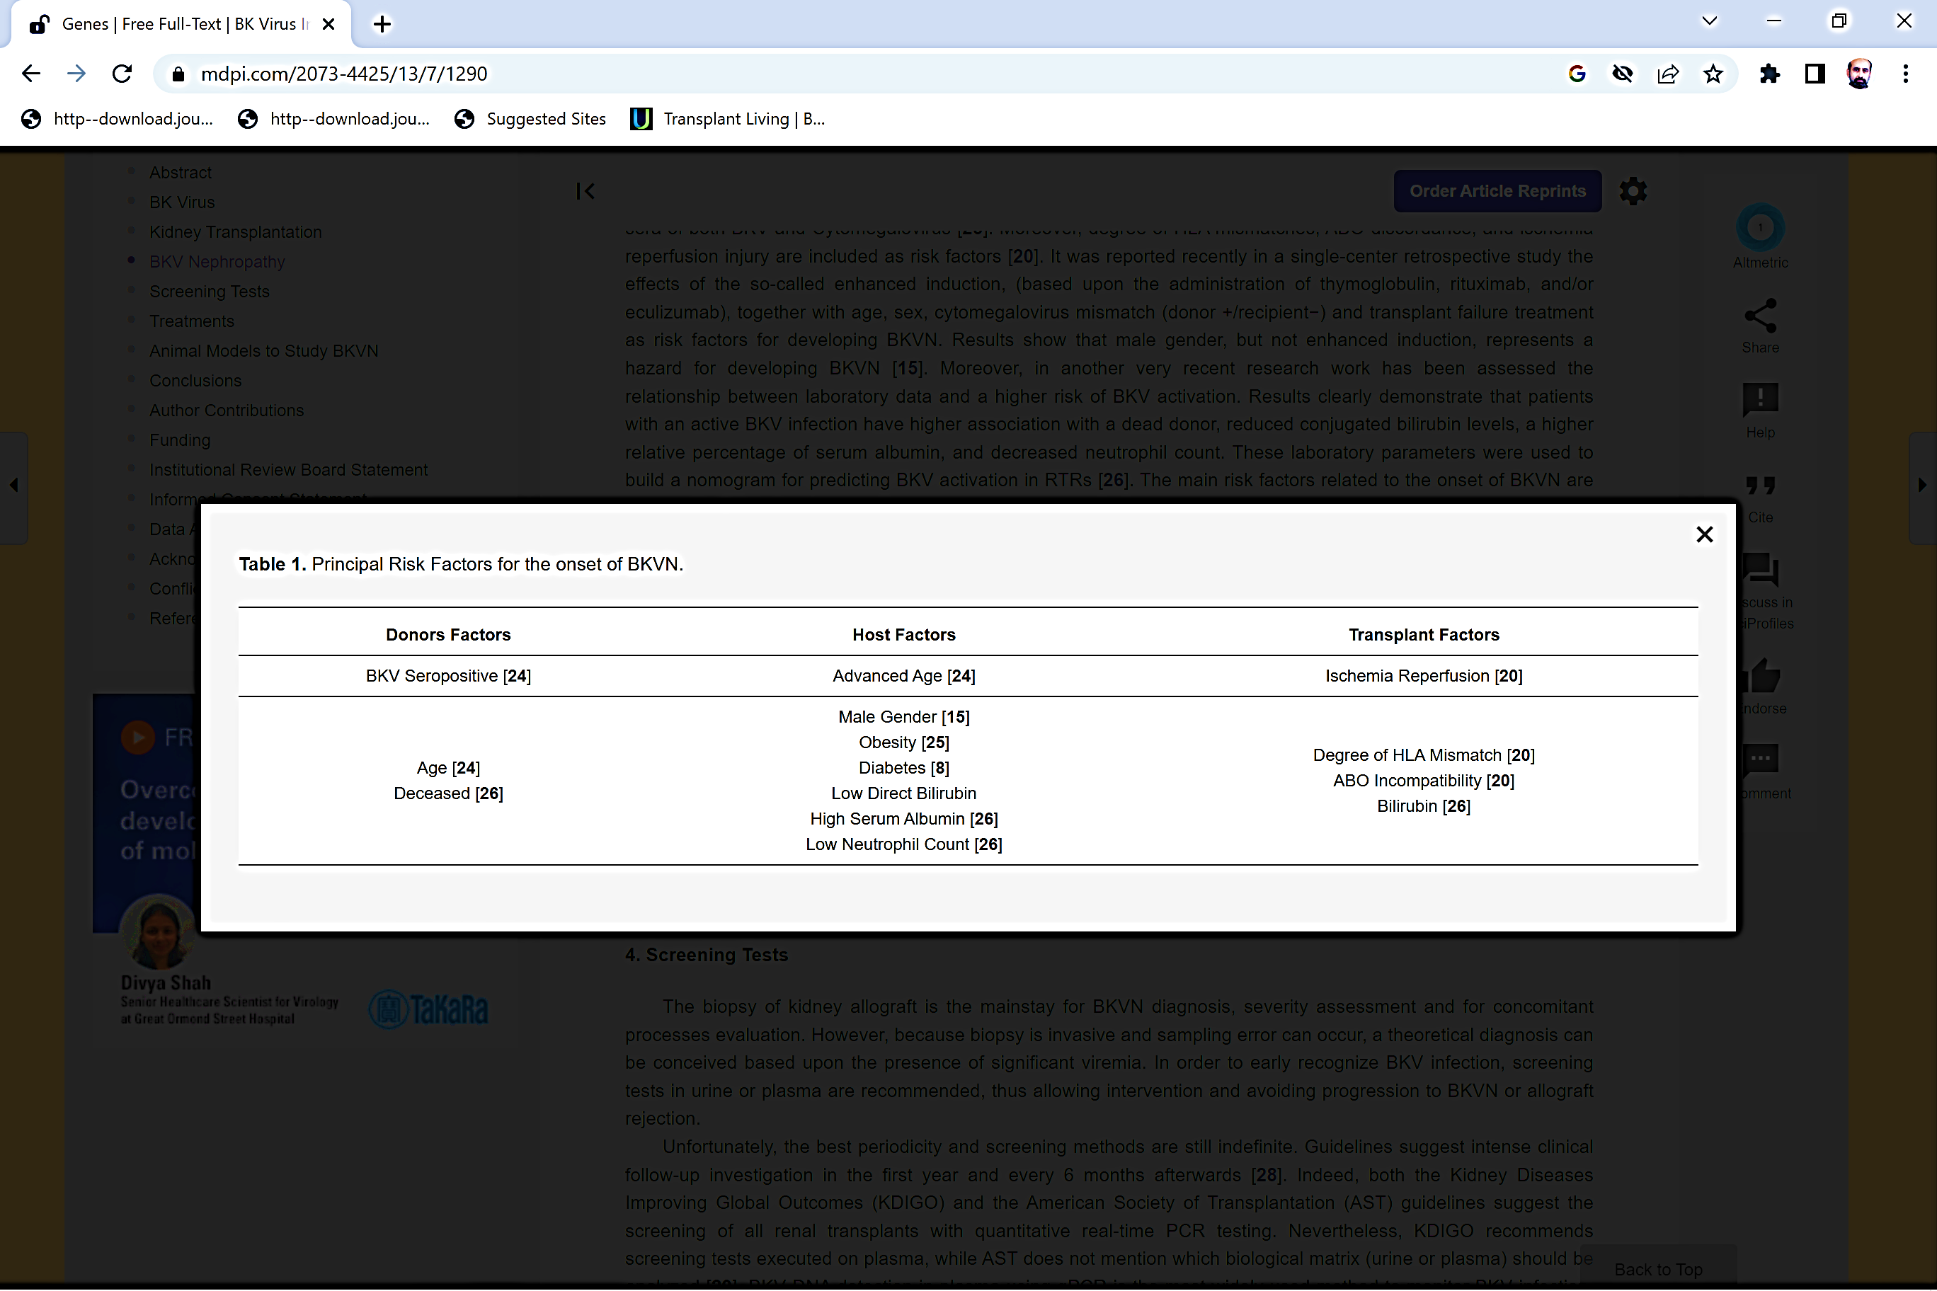
Genes 2022, 13(7), 1290

Slide 11
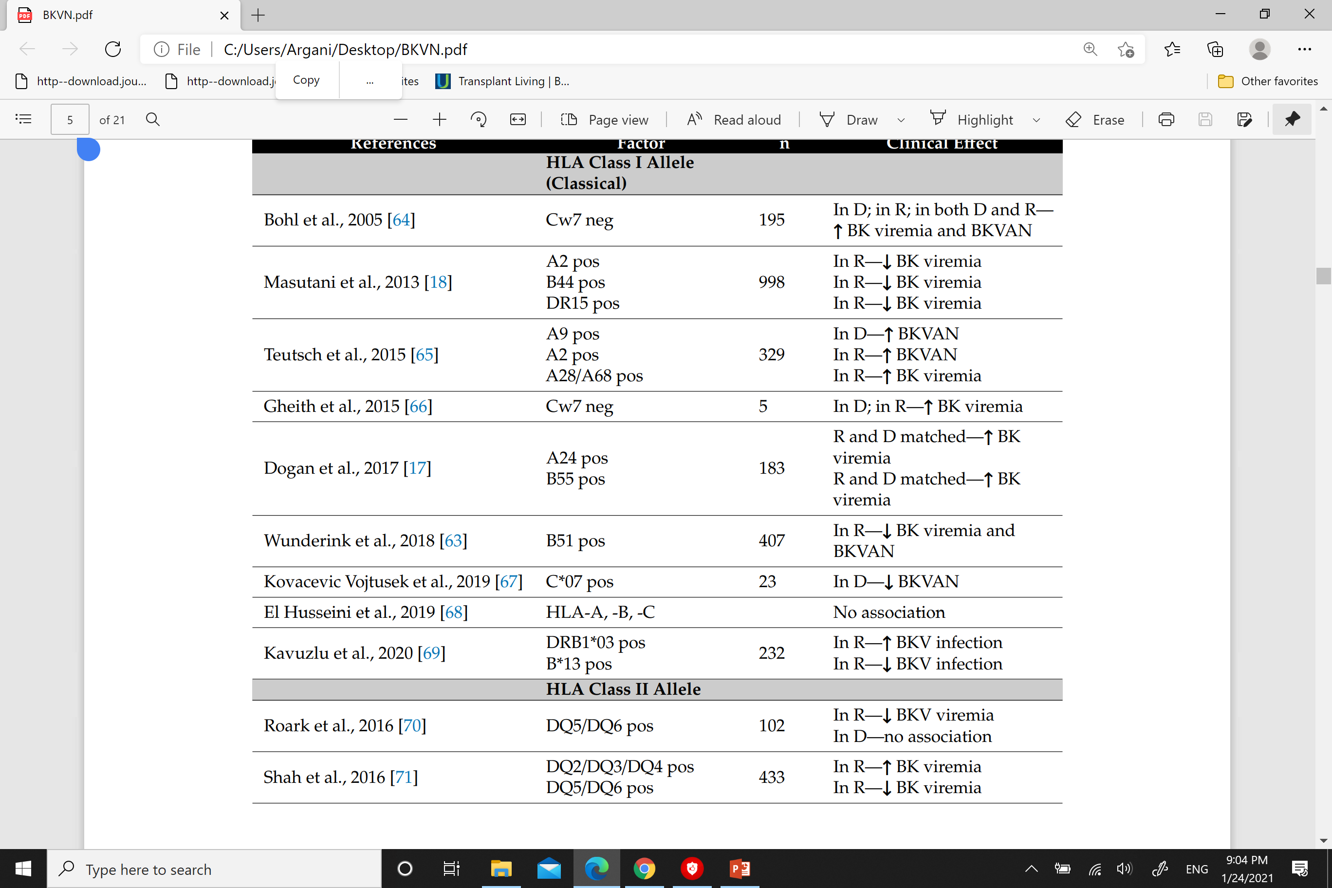
Protective/or deleterious effect of HLA alleles to BK viremia and/or risk for BKVAN
Viruses 2020, 12, 1417;1-21

Slide 12
Factors associated with decreased risk of BKV nephropathy
recipient HLA-B51 positivity
Polycystic kidney disease

Slide 13
Definitions& Risk factors
Clinical manifestations
Diagnosis
Treatment

Slide 14
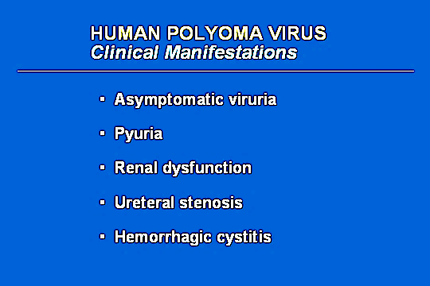

Slide 15
Unusual manifestations of BKV
Hemorrhagic cystitis
It is a rare manifestation of BKV. It is commonly reported among hematopoietic cell transplant recipients.
Four degrees of disease severity were recognized:
grade I: microscopic hematuria;
grade II: macroscopic hematuria;
grade III: hematuria with clots;
grade IV: hematuria with clots, clot retention, and renal failure secondary to obstructive nephropathy
genitourinary cancers
There is a putative link between BKV and the development of genitourinary cancers.

Slide 16
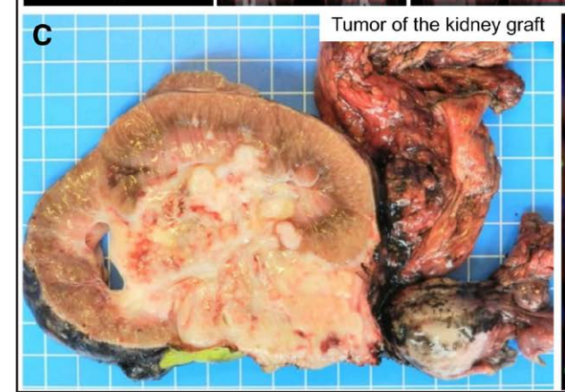
Transplantation 2021;105: 423–429).

Slide 17
Clinical Judgment for BKVN
Increased cr may be the only manifestation of BKVN
The incidence of BKVN is highest in the first 2-8 months posttransplant.
In many cases it can occur years after transplantation.
The incidence of late BKVN is highest in patients with multi-organ transplants and is possibly related to the more intensive immunosuppressive regimens used for these patients.

Slide 18
12 weeks
Viruria Viremia Nephropathy Allograft loss
Progression of BKVN by months

Slide 19
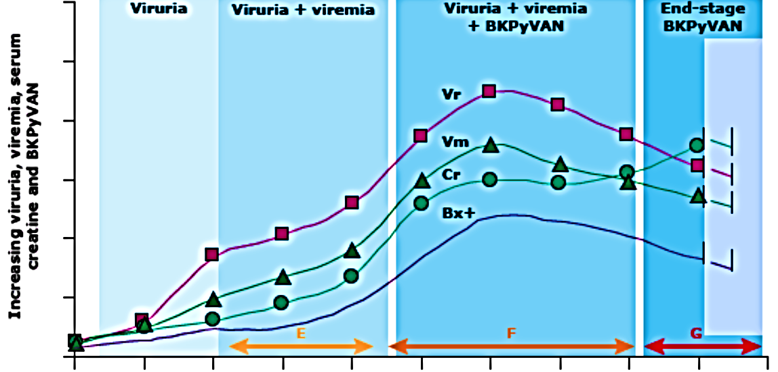
Course of BK-induced nephropathy
Post Tx. Follow-up (months)

Slide 20
Definitions& Risk factors
Clinical manifestations
Diagnosis
Treatment

Slide 21
The best policy
Methods for early screening.
Early (pre-transplant) risk stratification.

Slide 22

Diagnostic tests for BKV
Tests to diagnose infection.
Tests to diagnose replication.
Tests to diagnose disease.
PCR
urine
cytology
Serology
Histopathology

Slide 23
Viruria
Viruria is the earliest manifestation of BKV infection➔affecting 25-30% of patients during the first year following RTX .
Viruria is asymptomatic, detected only by screening, and may not progress to viremia.
urine PCR for BKV is not useful for monitoring the response to therapy.

Slide 24
Shedding of BKV in the urine (By PCR)
Healthy older adults
Pregnancy
Any immunosuppressive therapy

Slide 25
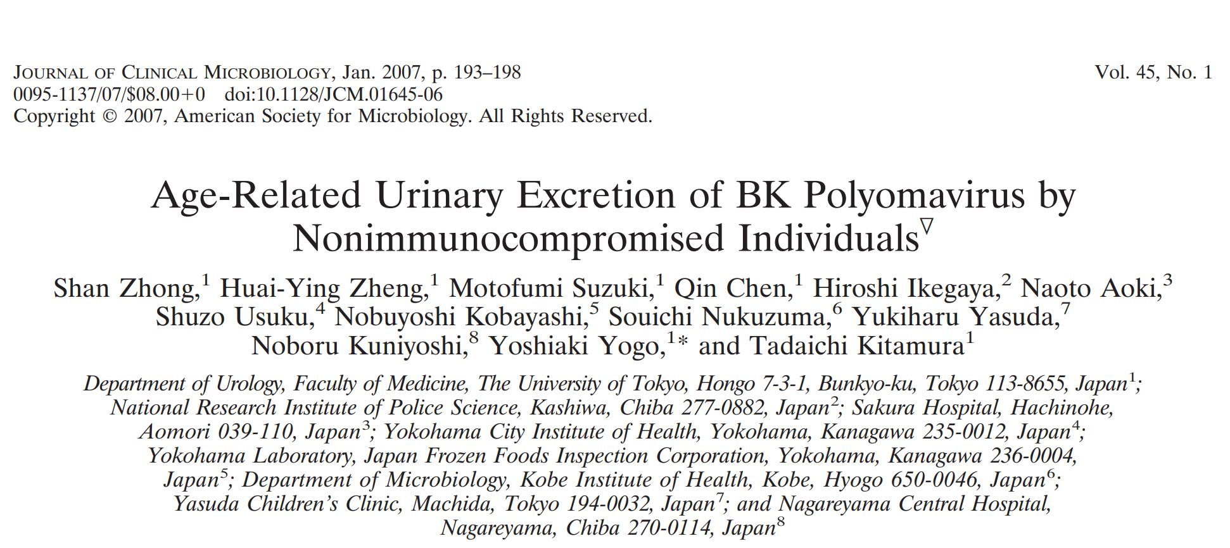


Slide 26
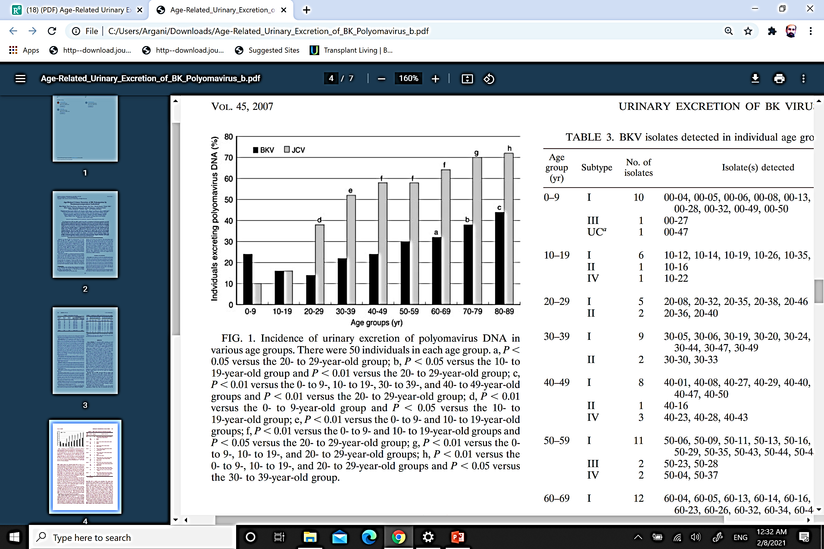

Slide 27
Urine Sediment in BKVN
Normal
Pyuria
Hematuria
Cellular casts (WBC and epithelial)
Decoy Cells

Slide 28
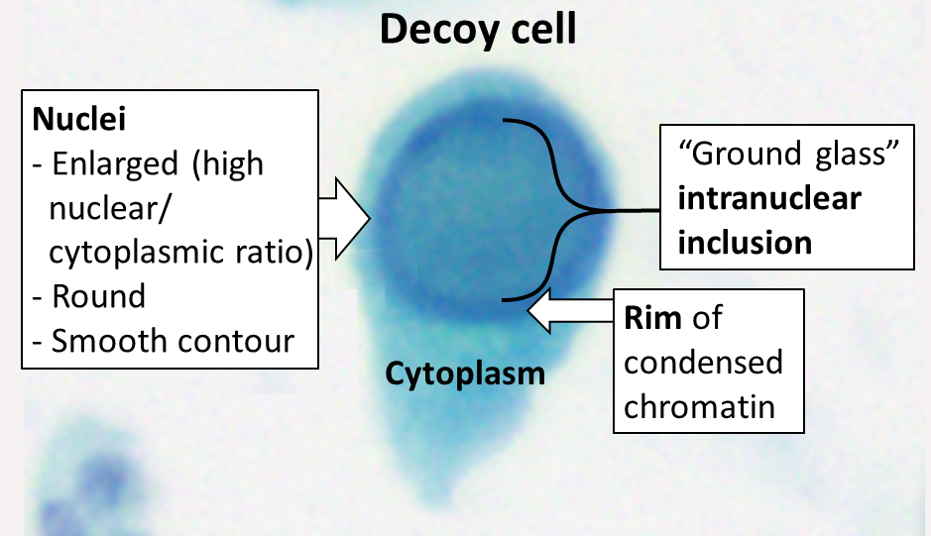
Urothelial origin
Sign of viral activation
Not diagnostic for BKVN
Normal renal function
PPV=27%
NPV=100%

Slide 29
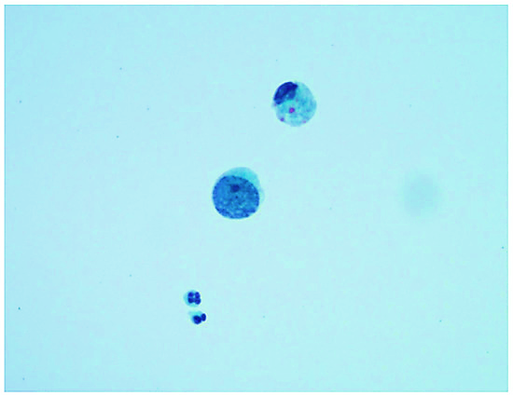
A “decoy cell” with an enlarged nucleus and clumped chromatin, mimicking high-grade urothelial atypia

Slide 30
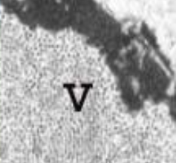
Electron microscopy
Shows the contrast between the thousands of newly formed virions inclusions (V) in the nucleolus.

Slide 31
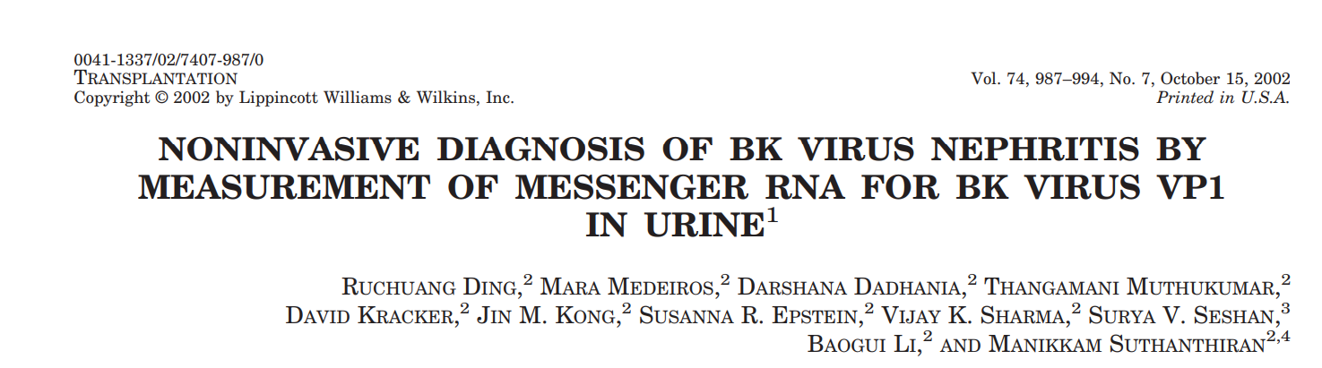
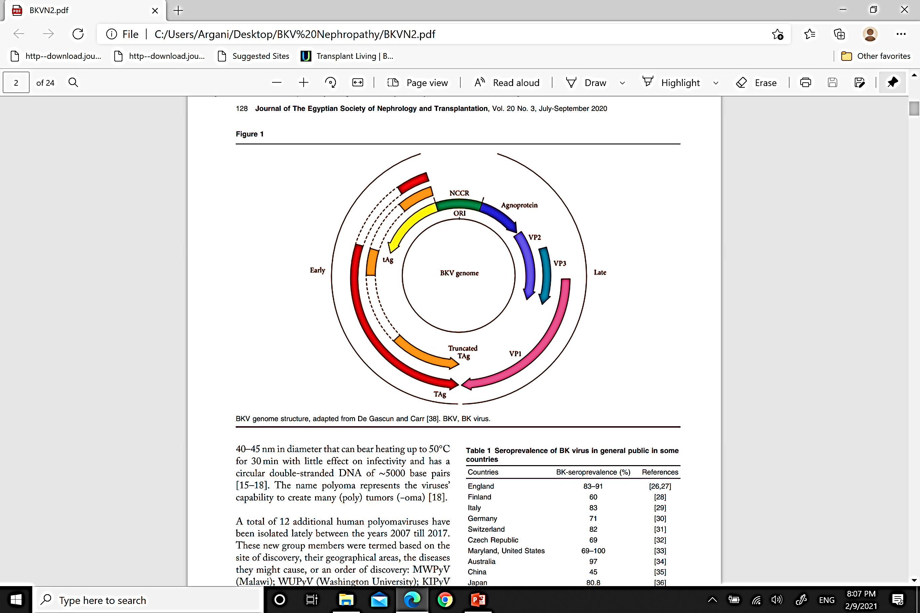

Slide 32
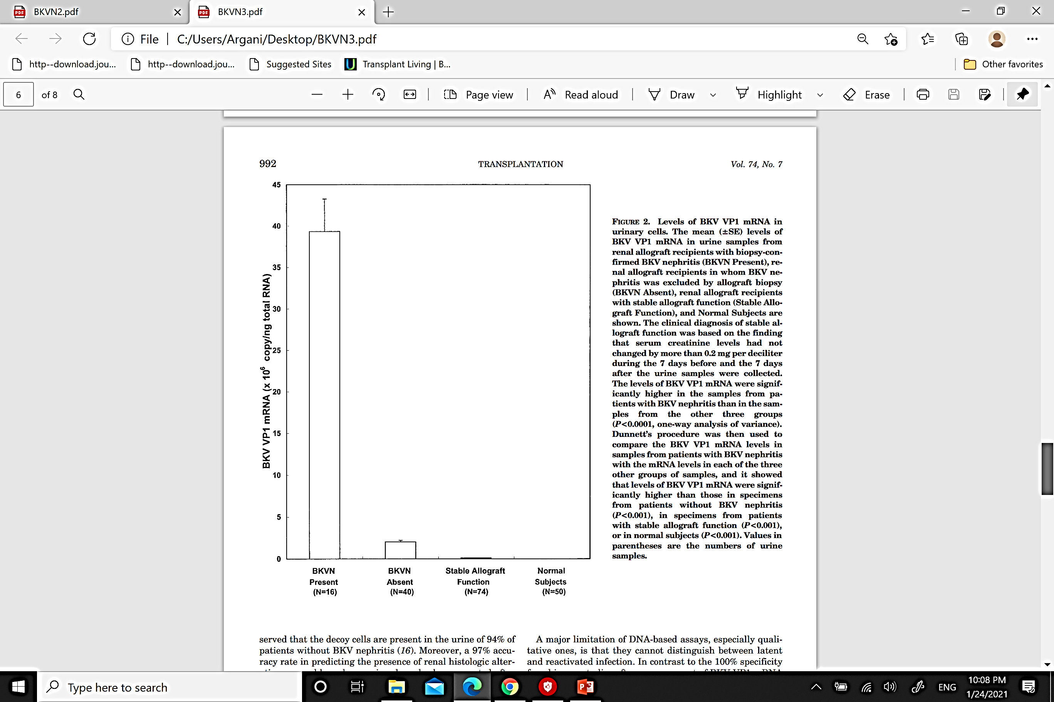
Levels of BKV VP1 mRNA in urinary cells
Conclusions
Measurement of BKV VP1 mRNA in urinary cells offers a noninvasive and accurate means of diagnosing BKV nephritis.
Transplantation. Vol. 74, 987–994, No. 7, October 15, 2002

Slide 33
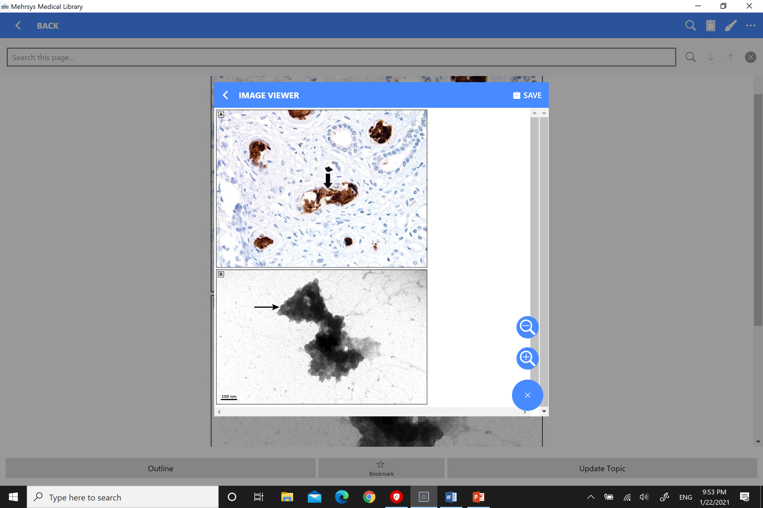
Haufen Bodies
Aggregate of BKV particles and Tamm-Horsfall protein
Corresponds to intensive BK viremia (Usually> 1 million copies/ml)

Slide 34
Valuable of the Haufen Bodies
Sensitivity, specificity for BKVN> 95 percent.
It may be used if renal allograft biopsy cannot be safely performed.
It may be used in children.

Slide 35
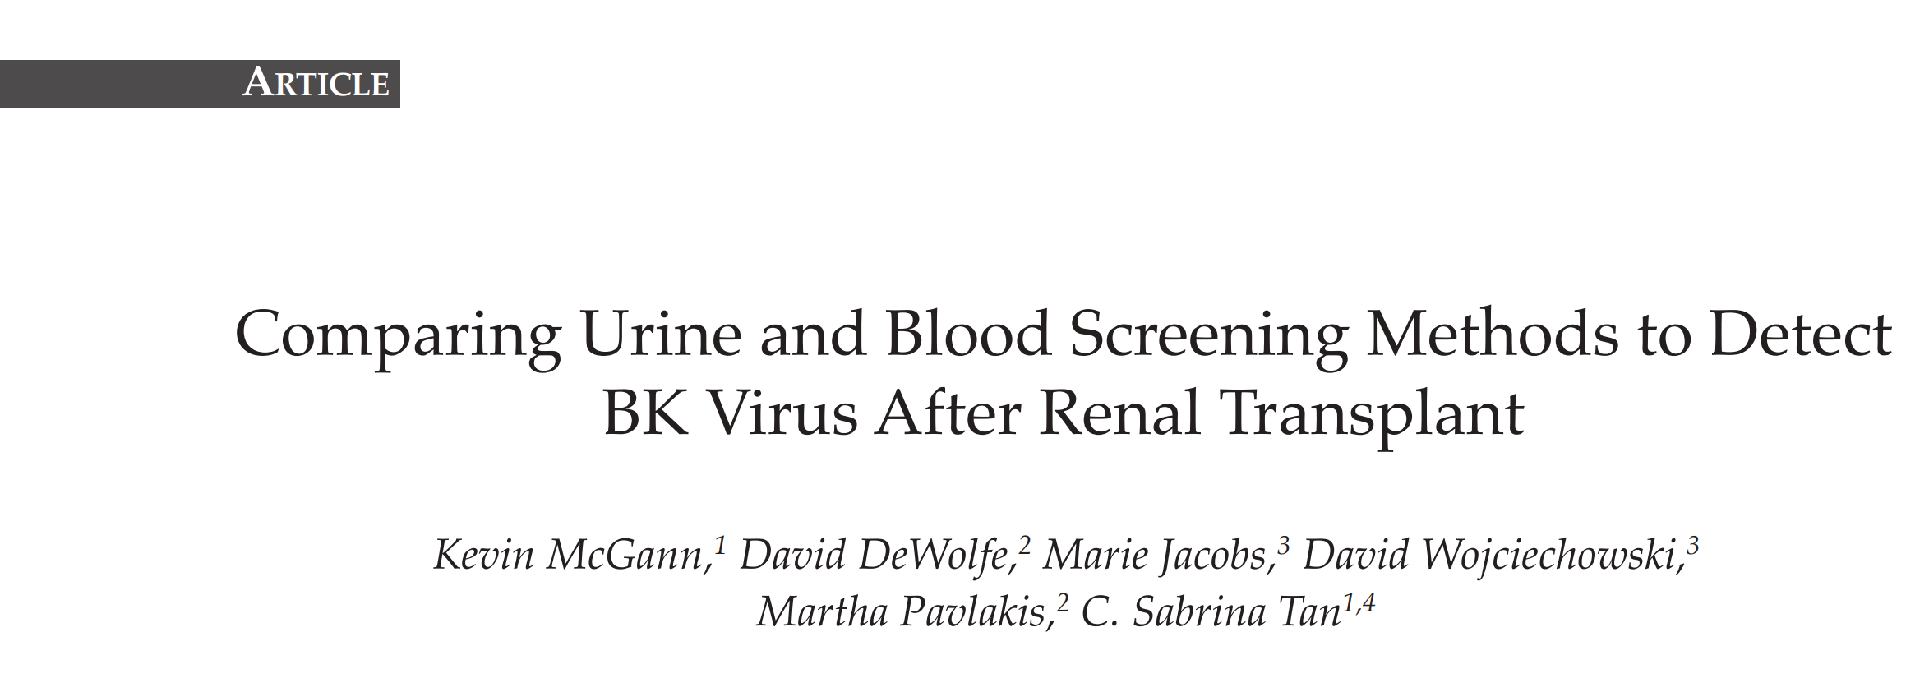
Experimental and Clinical Transplantation (2021) 2: 104-109
209 patients with BKVN pre-screened by Urine and Plasma PCR

Slide 36
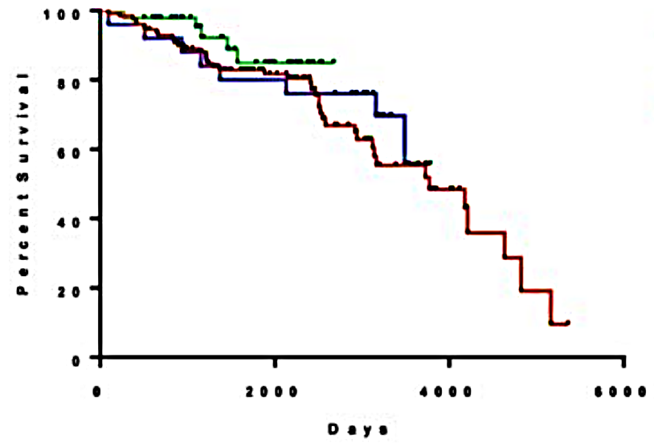
Graft Survival in Group Screened by Urine compared with Blood PCR
Urine PCR
Blood PCR
Percent Survival
2000
4000
6000
Days Post Transplant
Experimental and Clinical Transplantation
(2021) 2: 104-109

Slide 37
CONCLUSION
Urine screening performed in the early post-transplant period may be effective for early detection of BKV reactivation.
Allow lowering of immunosuppression and affect graft outcome.
Experimental and Clinical Transplantation
(2021) 2: 104-109

Slide 38
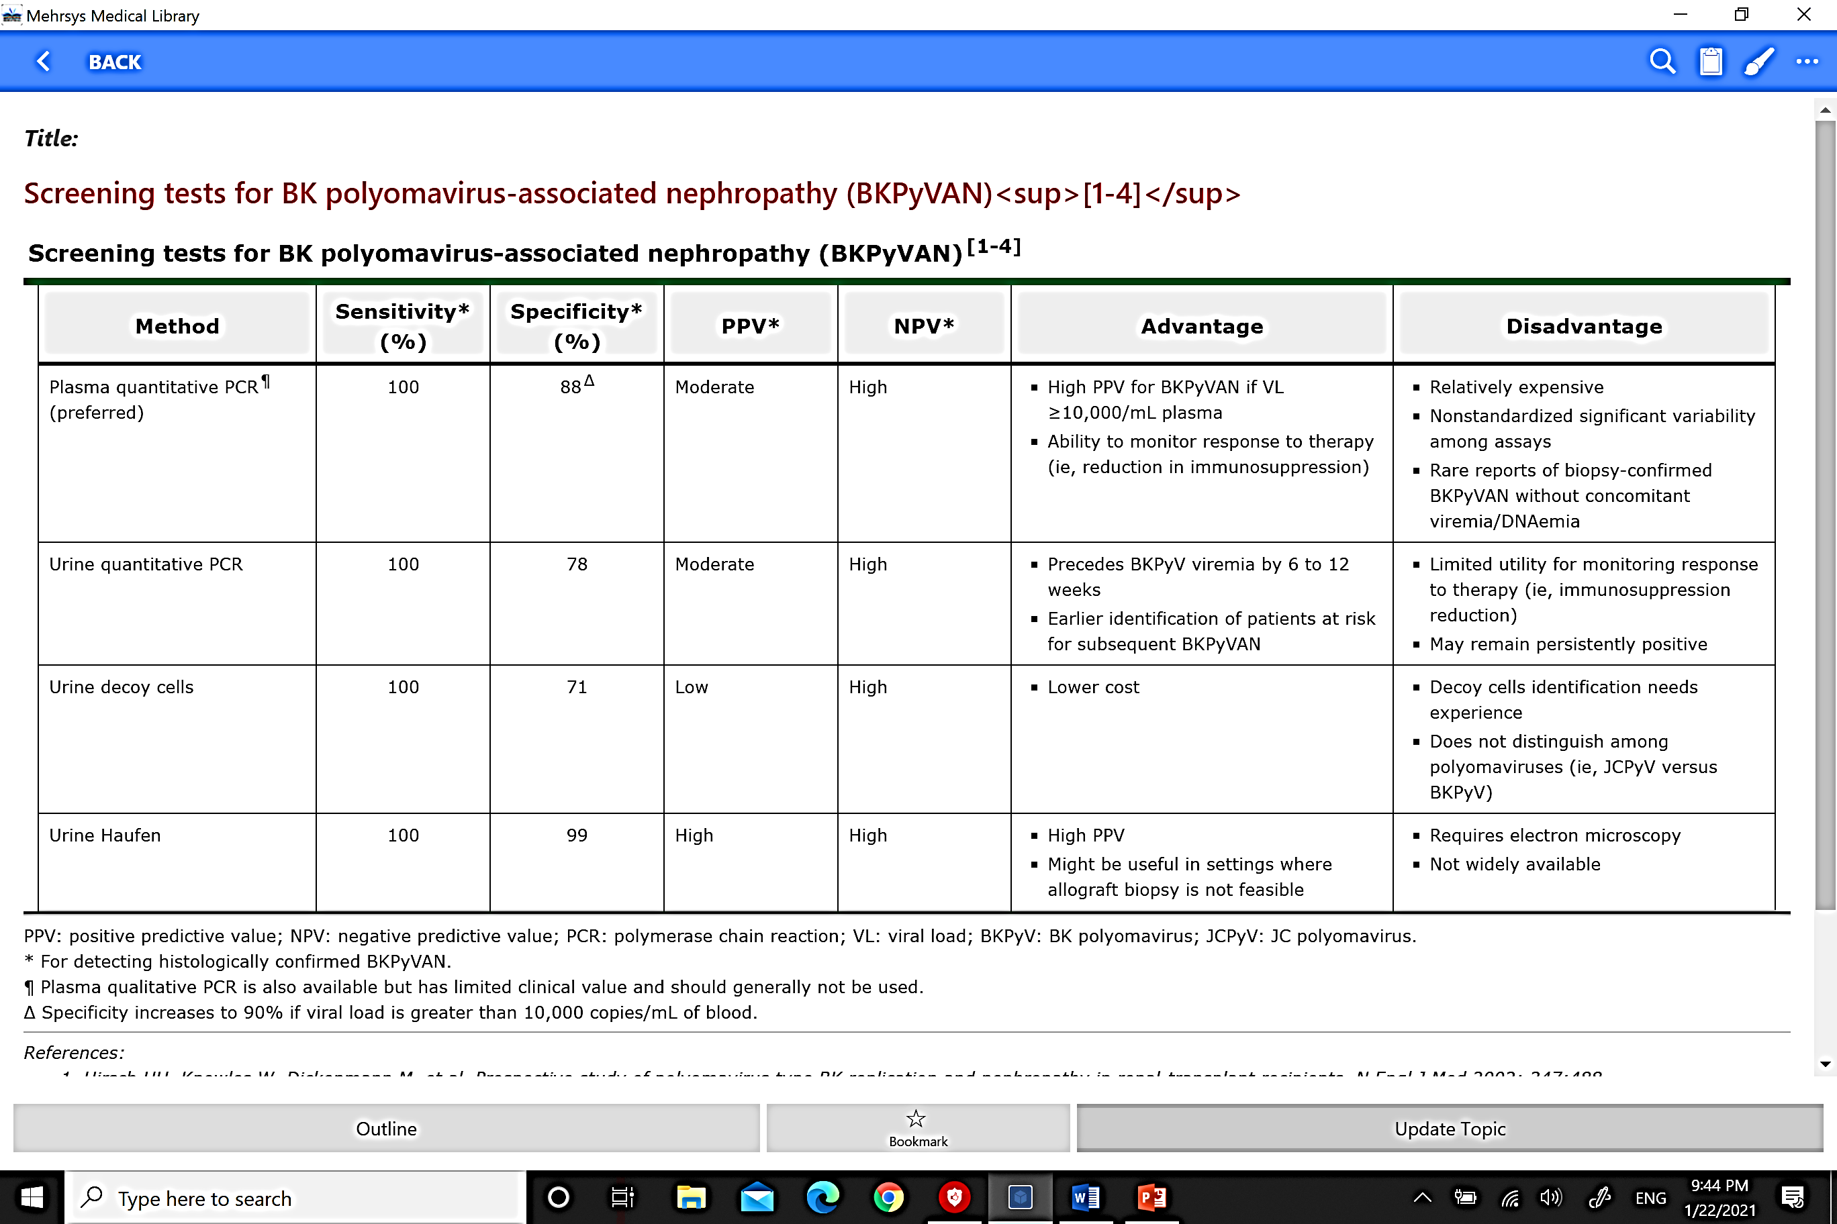
Conclusion for Urine Screening tests for BK polyomavirus-associated nephropathy
Urine quantitative PCR
High
Precedes BKV viremia by 6-12 weeks
Earlier identification of patients at risk for subsequent BKVN
Limited utility for monitoring to therapy
May remain persistently positive
100
78
Urine Decoy cell
100
71
Low
High
Lower cost
Decoy cells identification needs experience
Does not distinguish various polyoumas
Urine Haufen
100
99
High
High
High PPV
Might be useful where biopsy is not feasible
Requires Electron microscopy
Not widely available

Slide 39
Viremia
Viremia in 10%-30% of recipients in first six months post-Tx. and in 5% to 10% thereafter.
As with viruria, viremia is typically asymptomatic.
Viremia has greater PPV than viruria for progression to BKVN.
Viremia is present in nearly all patients with BKVN
Viremia is an indication to reduce immunosuppression.
Higher viral loads ➔greater predictive value for BKVN.

Slide 40
The threshold of plasma BKV
Levels >1000 copies/mL are considered positive.
Levels >10,000 copies/mL correlate with biopsy-confirmed BKVN.

Slide 41
Serial estimate of viremia
The best technique to demonstrate resolution of BK activity following reduction of immunosuppression.
Significant, sustained Viremia (>5000 BKV copies/mL for 3 consecutive weeks) characterizes patients with high, uncontrolled viral replication, leading to parenchymal injury.
It is required to follow-up patients who lost their allograft because of BKVN and considered for Re-transplantation

Slide 42

KDIGO guidelines for kidney transplant recipients :
Screening all recipients of BKV using quantitative plasma PCR at least monthly for the first 3 to 6 months after Tx. then every 3 months until the first year, and subsequently whenever there is an unexplained rise in serum creatinine and after treatment for acute rejection.

Slide 43

AST guidelines for kidney transplant recipients:
Recommend quantitative PCR monthly up to month 9 post-transplant followed by testing every 3 months up to 2 years
or at the time of surveillance and indication of an allograft biopsy.

Slide 44
False negative of PCR?
PCR primers are less sensitive to genotypes 2,3 and 4 (10/000 copies of those are necessary to become PCR +ve than Genotype 1).

Slide 45
Plasma Screening tests for BK polyomavirus-associated nephropathy
100
90
Moderate
High
High PPV if PCR>10/000
Ability to monitor response to therapy
Relative Expensive
Non standardized between assays
Rare reports of BKVN without concomitant DNA positivity
¶ Plasma qualitative PCR is also available but has limited clinical value and should generally not be used.

Slide 46
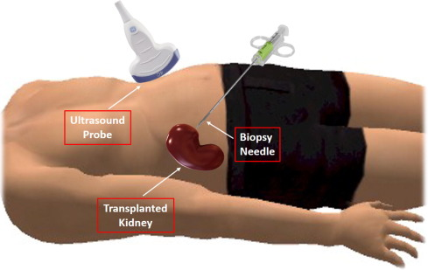
Indication of Renal biopsy in the BKVN
If the cause for renal allograft dysfunction is uncertain.
If kidney dysfunction and/or viremia fail to resolve despite reducing immunosuppression.

Slide 47
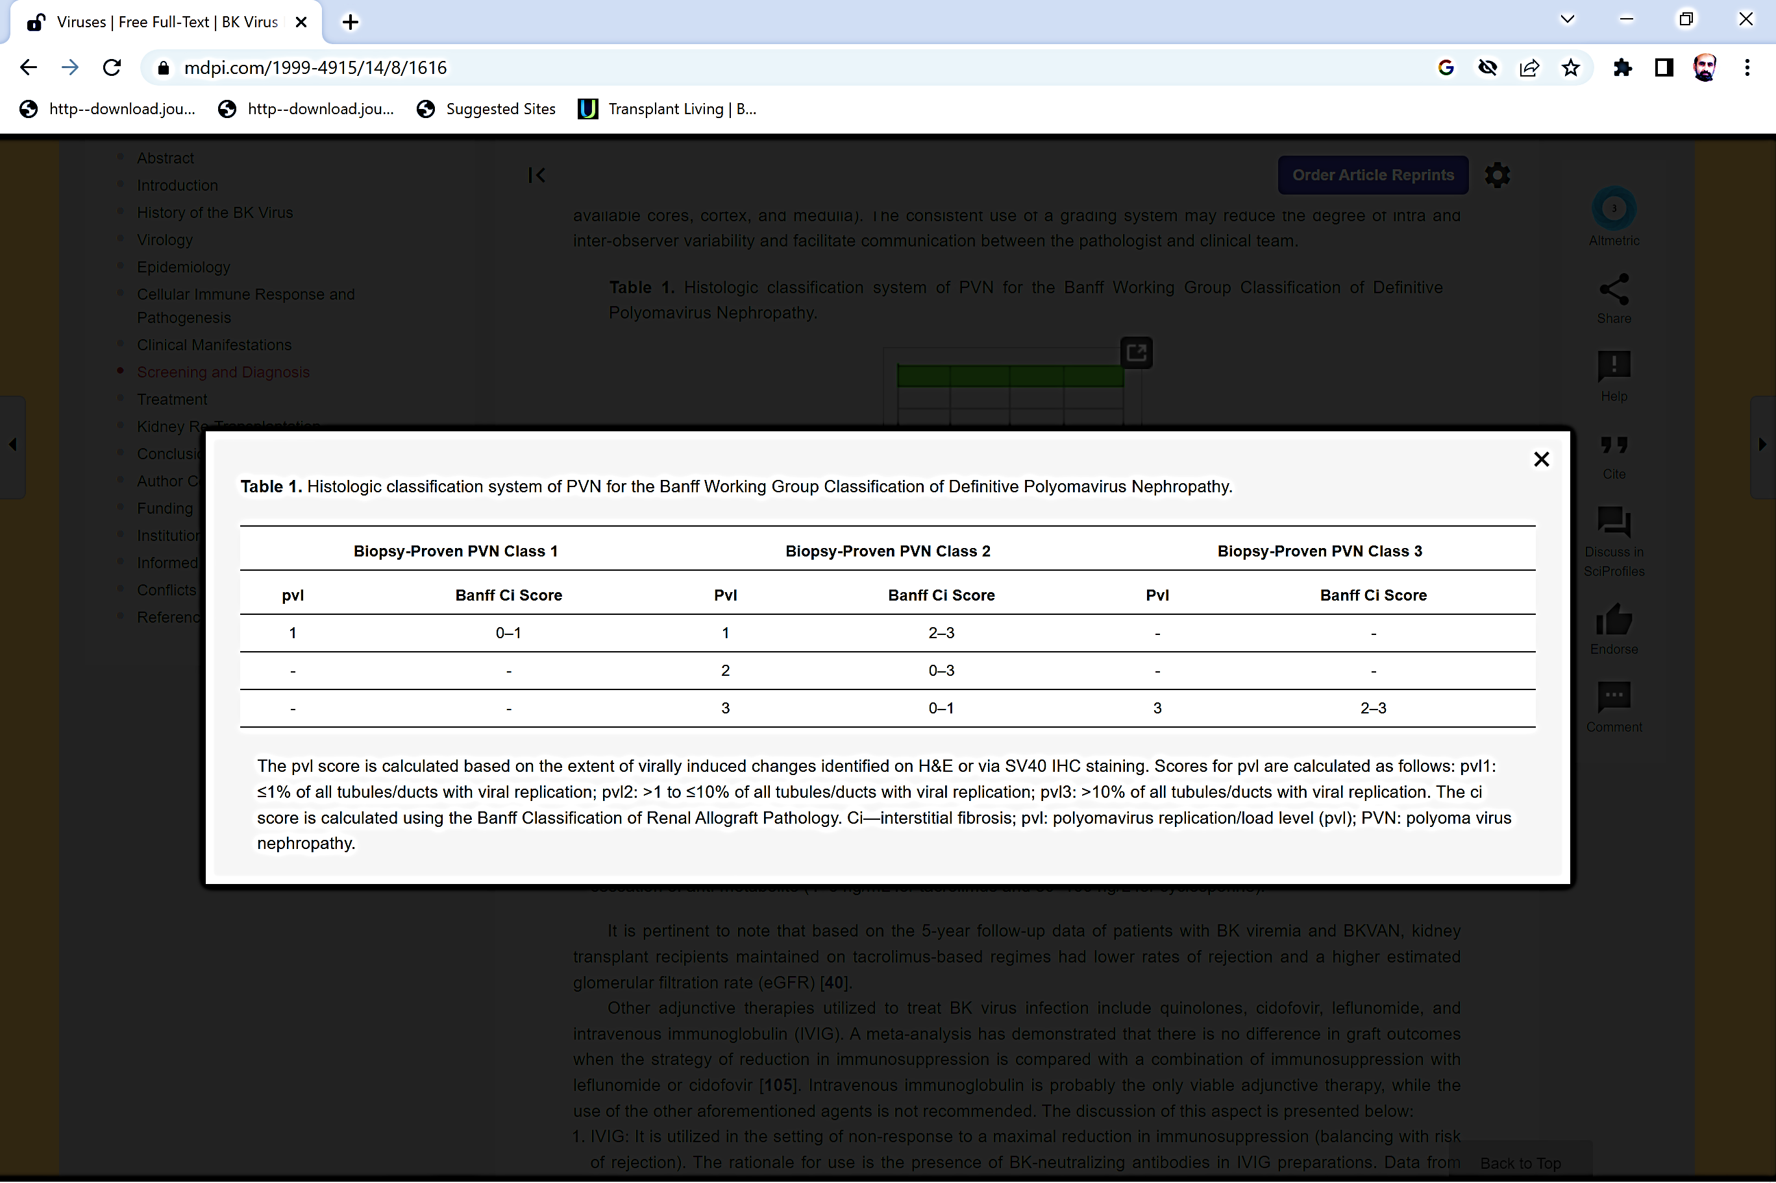

Slide 48
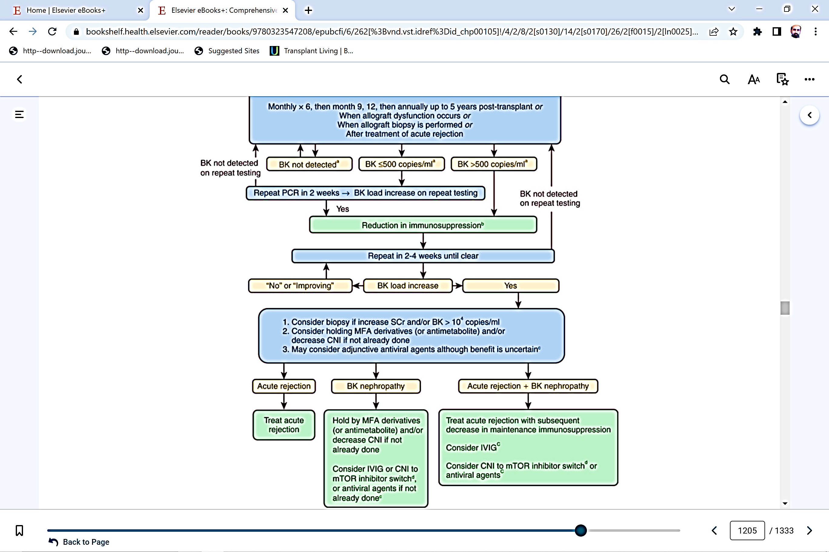
Renal Biopsy

Slide 49
Definitions& Risk factors
Clinical manifestations
Diagnosis
Treatment

Slide 50
Course of BK-induced nephropathy
Intervention is not indicated
Ineffectual, late intervention
Post Tx. Follow-up (months)

Slide 51
Course of BK-induced nephropathy
Late diagnosis decreases the likelihood of viral clearance.
Later diagnosis associated with higher rates of premature graft loss (30 versus 10%).
Preemptive intervention leads to resolution of the infection in 85 to 90% of cases.
Risk of acute rejection is low (10 to 15%)
Post Tx. Follow-up (months)

Slide 52
Therapeutic Interventions Targeting BK Virus Replication
Manipulation of Immunosuppressive Therapy
Antiviral Agents
Antiviremic and Antifibrotic Combination Therapy

Slide 53
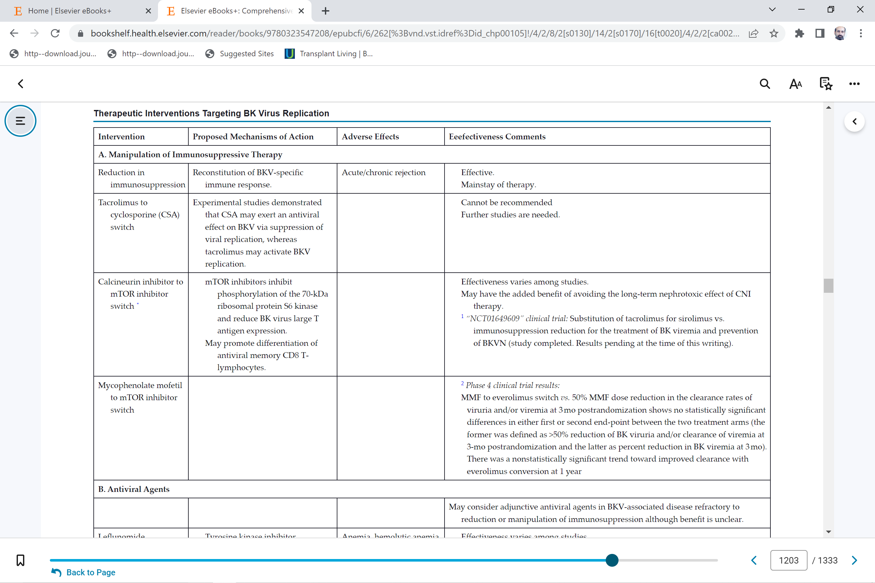
Therapeutic Interventions Targeting BK Virus Replication-A

Slide 54
When Immunosuppressive should be reduced?
Stepwise reduction of immunosuppressive medications is recommended when BKV plasma PCR is persistently (for 3 weeks and longer) greater than 1000 copies per milliliter (mL)

Slide 55
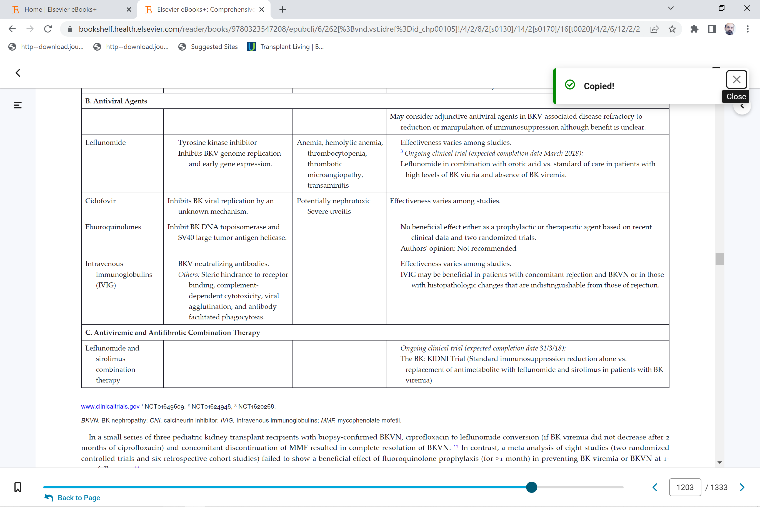
Therapeutic Interventions Targeting BK Virus Replication-B

Slide 56
Therapeutic Interventions Targeting BK Virus Replication-C

Slide 57
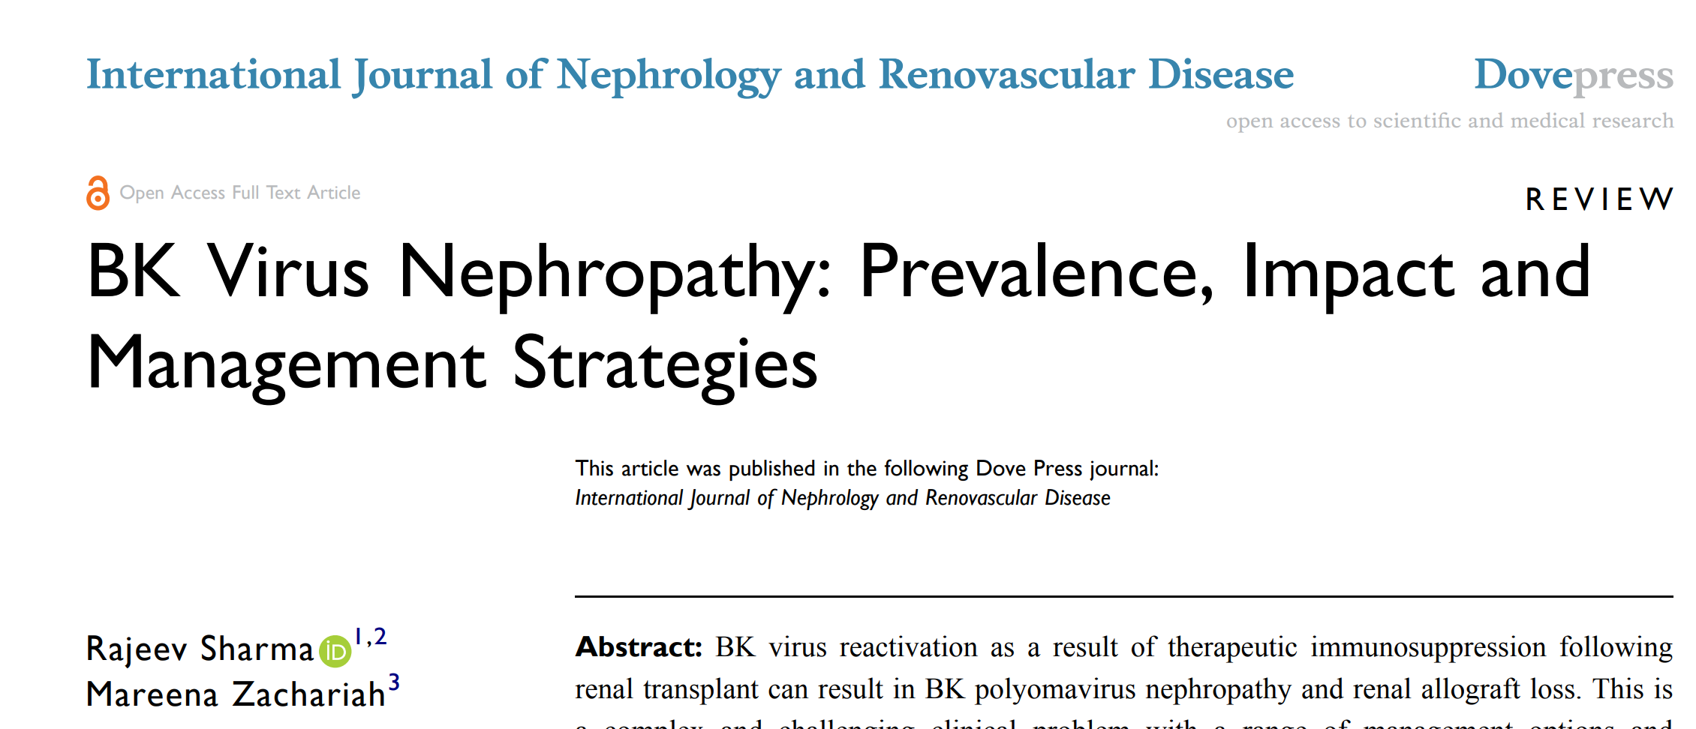
2020:13 187–192

Slide 58
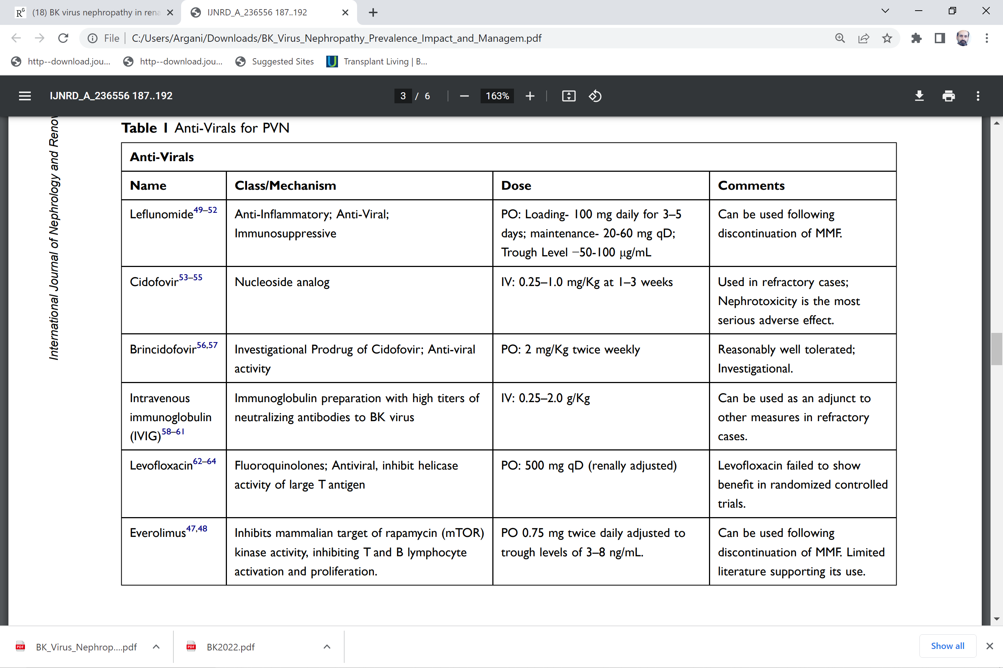
International Journal of Nephrology and Renovascular Disease 2020:13 187–192

Slide 59
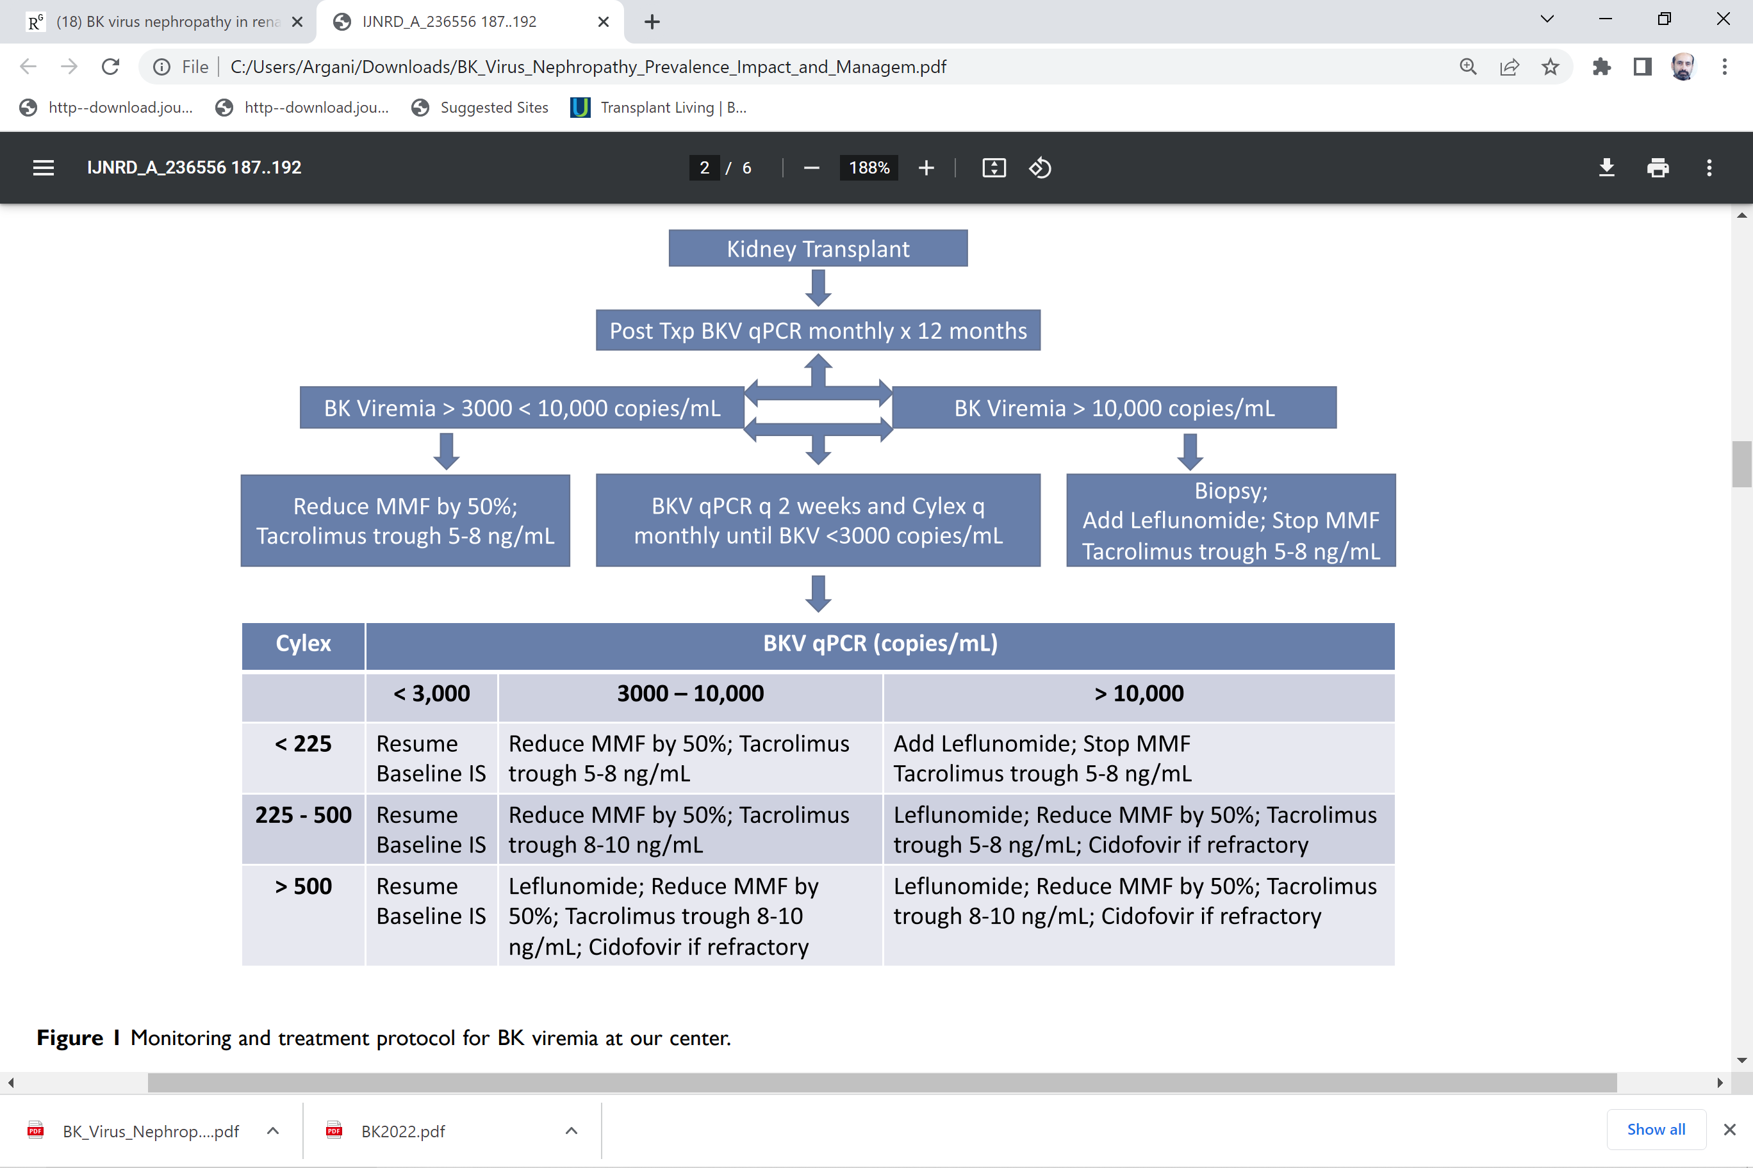
International Journal of Nephrology and Renovascular Disease 2020:13 187–192

Slide 60
Upcoming Therapeutic Trials

Slide 61
Monoclonal Ab
To assess the safety, pharmacokinetics, and efficacy of MAU868—a human monoclonal antibody (IgG1) that binds the viral capsid protein, VP1, which is responsible for binding to the surface of host cells (ClinicalTrials.gov identifier: NCT04294472).

Slide 62
posoleuccel
A phase 2 multicenter, randomized, double-blind, study of the safety, tolerability, and effectiveness of adoptively transferred posoleuccel (ALVR105) multivirus-specific T Cells in kidney transplant recipients with either high or low levels of BK viremia (ClinicalTrials.gov identifier: NCT04605484).

Slide 63
Considerations for Re-Tx. for failed allograft secondary to BKVN
BKV surveillance after re-transplant is most important.
Reduced immunosuppression if immunologic condition of recipient permits
Transplant nephrectomy to reduce BKVN before re-transplanting

Slide 64


